Slide 1

Datasoftixs Internship
Web Development
Name - Prradyum Gupta
Email-prradyumgupta@gmail.com

Slide 2
Projects:-
1.My Digital Portfolio
2.Task Master
3.Skywatcher's Companion

Slide 3
1.My Digital Portfolio
Objective:-
The goal of this project is to design a responsive and interactive portfolio website to showcase personal skills, achievements, and projects.
Tools Used :-
1.Frontend Development
HTML
CSS
JavaScript
2.Development & Deployment
VS Code – As the primary code editor.
Live Server (VS Code Extension) – For real-time preview.
Git & GitHub – For version control and project hosting.

Slide 4
Website Structure:-
The portfolio is structured into different sections:
Home Page – Displays a welcome message with a background image.
About Me – Showcases personal details, education, and interests.
Projects – Highlights key projects with code, explanations, and screenshots.
Skills – Lists technical and soft skills with icons or progress bars.
Contact – Provides a form for visitors to reach out via email or social media.

Slide 5
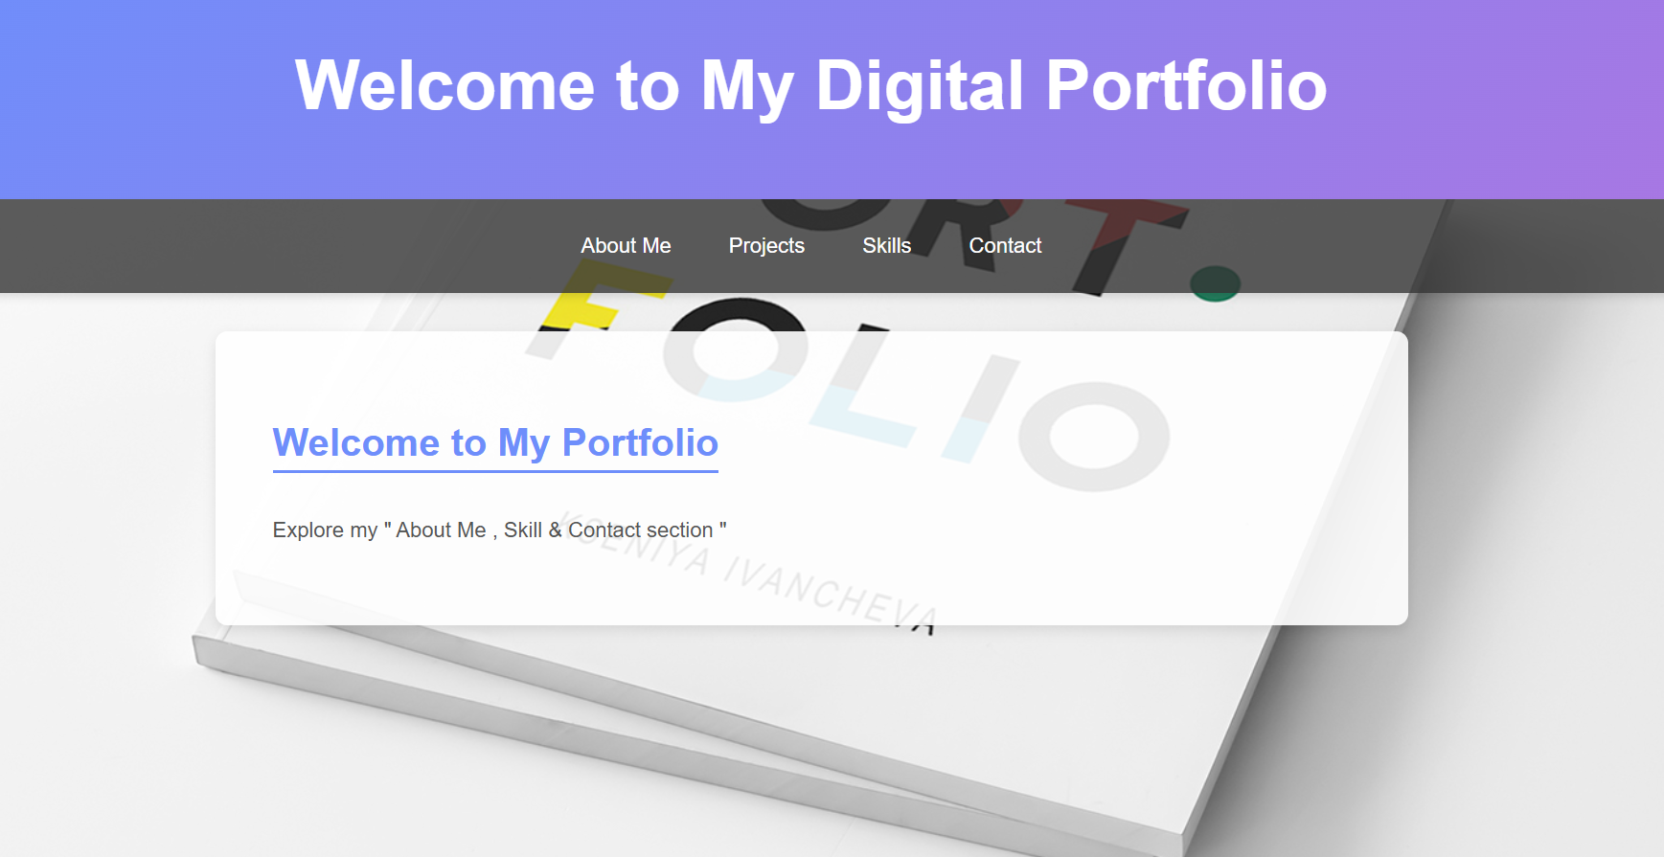
Website Image:-

Slide 6
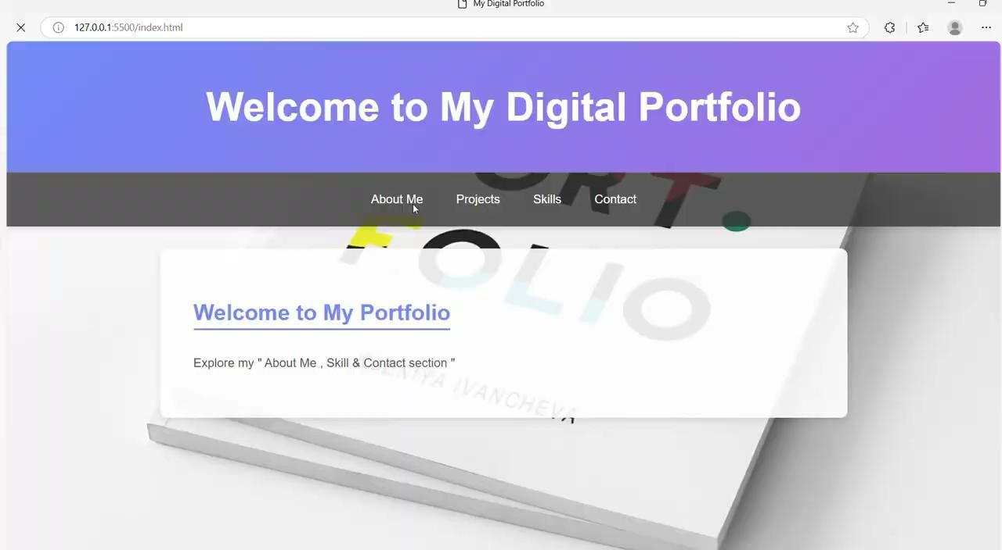
Website Video:-

Slide 7
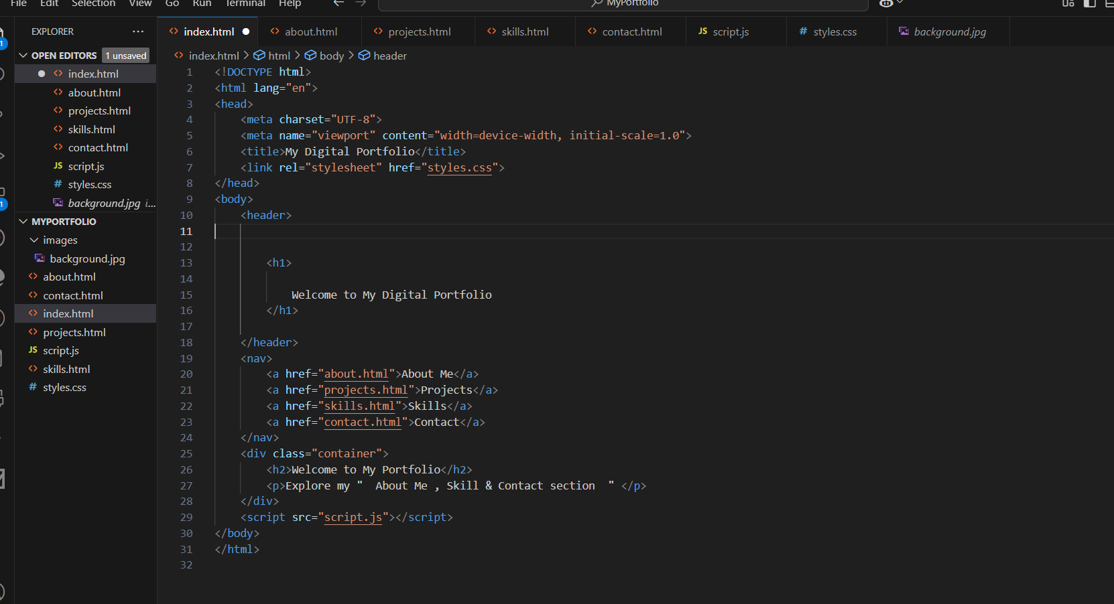
Code:-

Slide 8
2.Task Master
Objective:-
A simple and interactive to-do list application that allows users to add, complete, and delete tasks. Features include a dynamic progress bar, task persistence using JavaScript, and a visually appealing UI. The project consists of a landing page with a button to access the main task manager. Built with HTML, CSS, and JavaScript.

Slide 9
Tools Used in Task Master Project:-
Tools Used in Task Master Project
🖥 Technologies:
HTML – Structure of the web pages
CSS – Styling and layout
JavaScript – Functionality and interactivity
🛠 Development Tools:
VS Code – Code editor
Browser DevTools – Debugging and testing
Git & GitHub – Version control

Slide 10
Working:-
1️⃣ Landing Page:
A welcome screen with a "Make List" button.
Background image for a visually appealing look.
2️⃣ To-Do List Page:
Input field to add new tasks.
Tasks displayed in a list with: ✅ Complete button (turns green when clicked). ❌ Delete button (removes task).
Progress bar updating dynamically based on completed tasks.

Slide 11
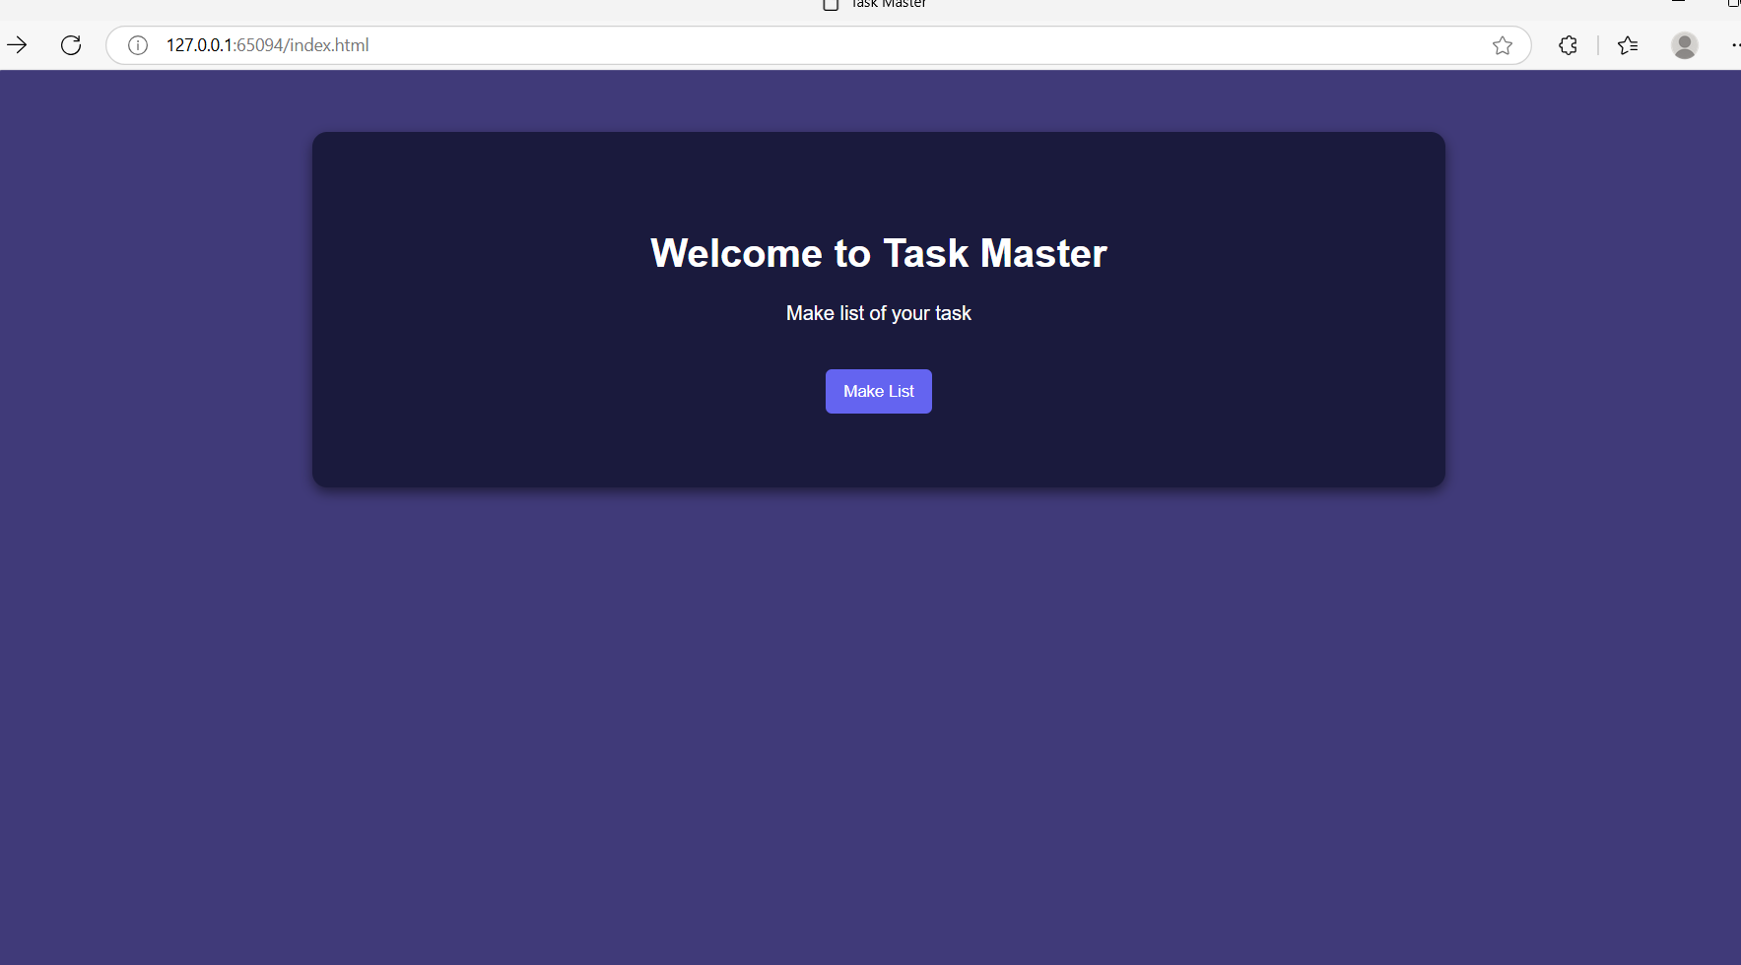
Website Image:-

Slide 12
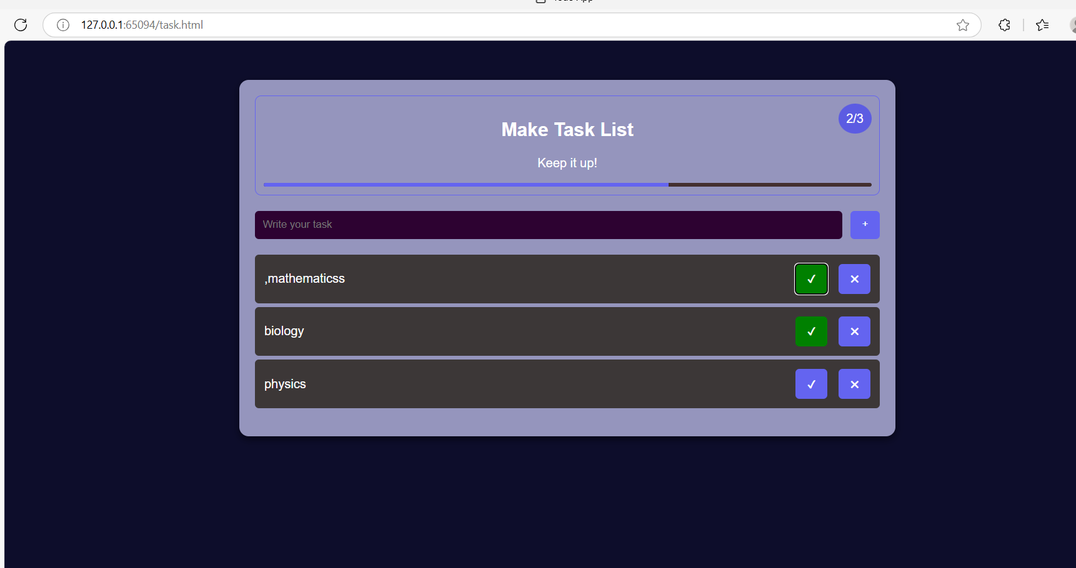
Website Image:-

Slide 13
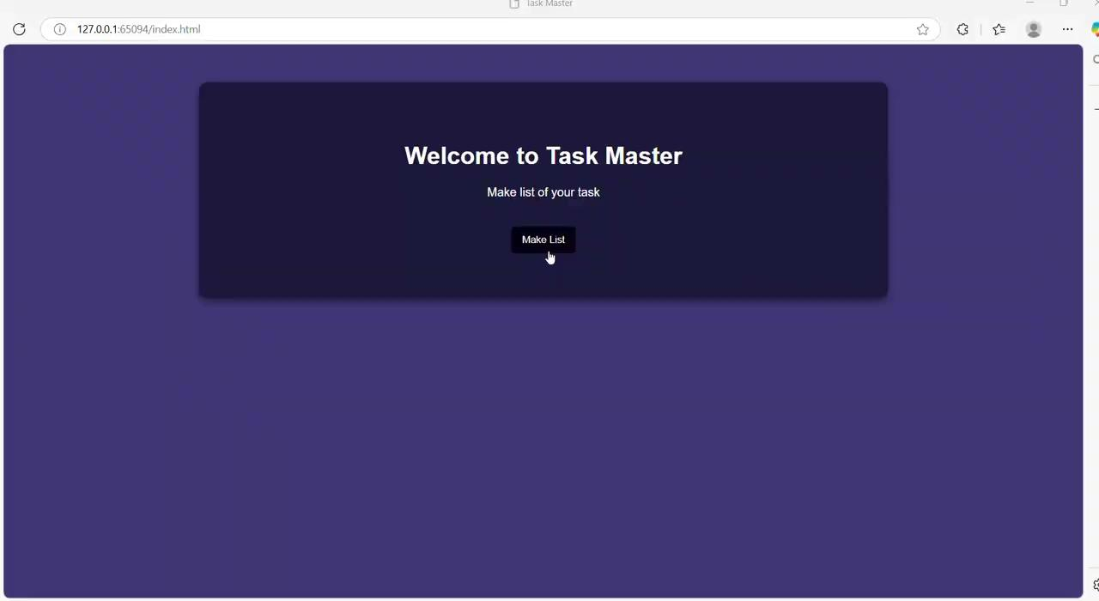
Website Video:-

Slide 14
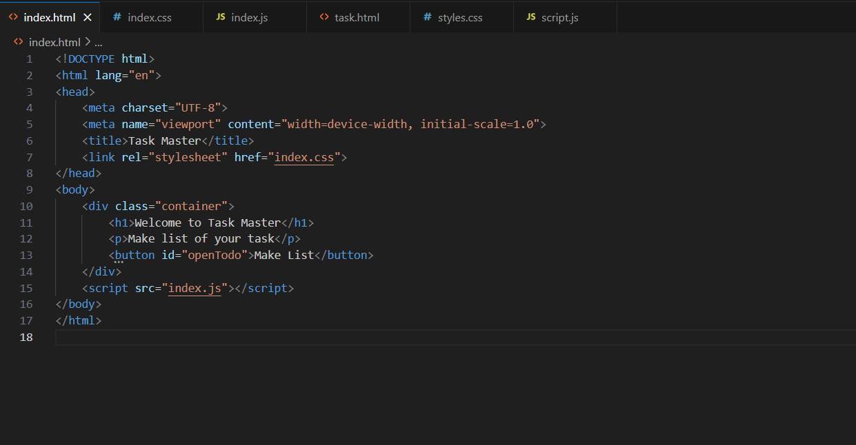
Code:-

Slide 15
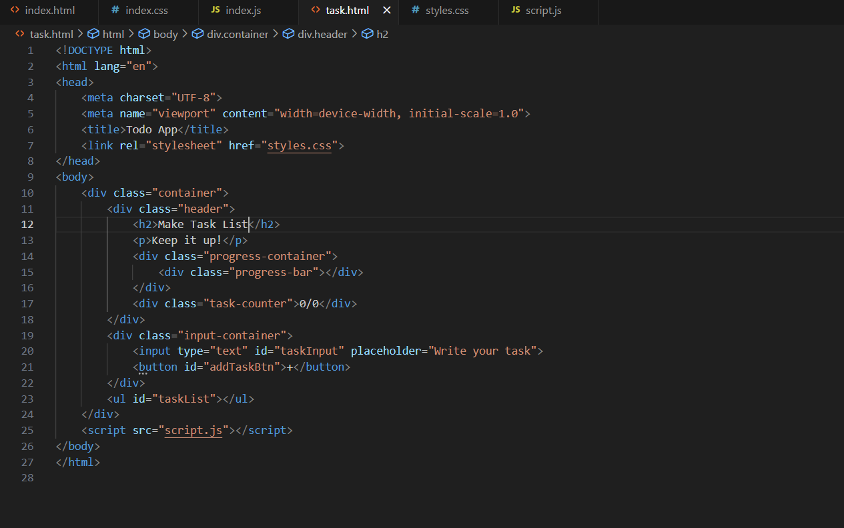
Code:-

Slide 16
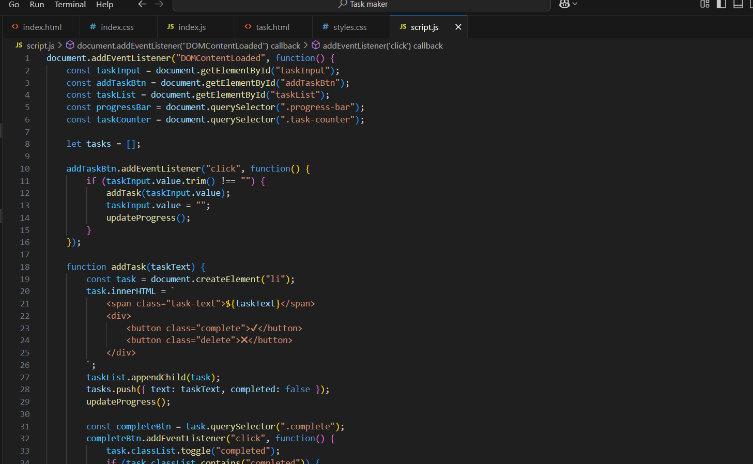
Code:-

Slide 17
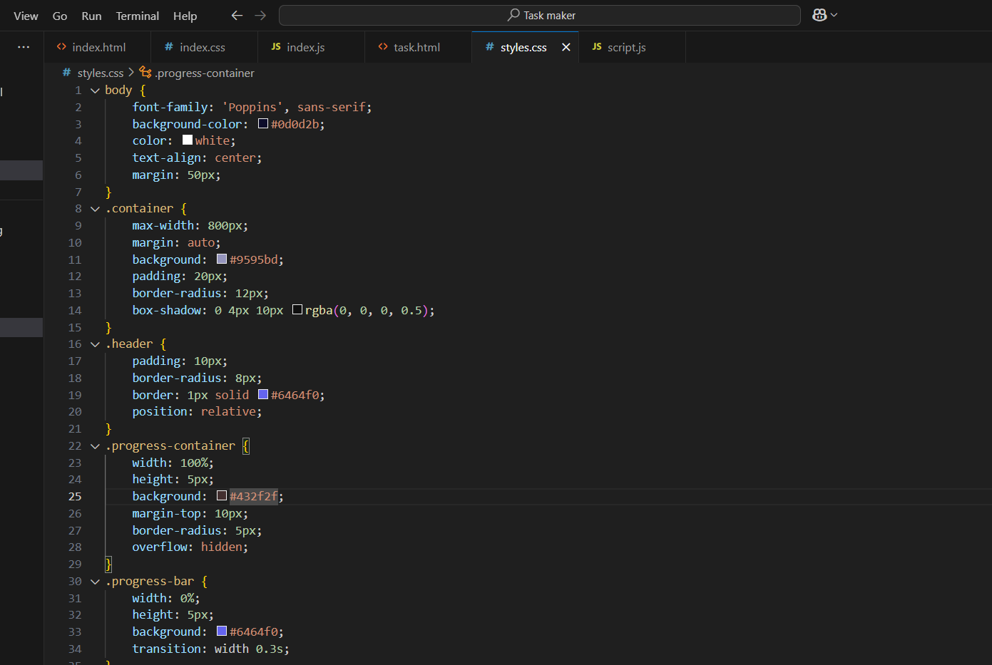
Code:-

Slide 18
Output:-
The Task Master project successfully provides a simple yet interactive to-do list application. It allows users to efficiently manage tasks with features like adding, completing, and deleting tasks while visually tracking progress. With a clean UI and local storage for persistence, this project enhances productivity and user experience.
Built using HTML, CSS, and JavaScript, it demonstrates core web development skills and interactive design principles.

Slide 19
3.Skywatcher's Companion
Objective:-
Skywatcher's Companion is a weather dashboard that provides real-time weather updates using the OpenWeather API. Users can search for any city to view temperature, humidity, wind speed, and weather conditions. The interface includes a search bar and a dynamic background that changes based on the weather. Built with HTML, CSS, and JavaScript, this project enhances skills in API integration and responsive design.

Slide 20
Tools Used:-
1. Frontend Development:
HTML – Structure of the website
CSS – Styling and layout
JavaScript – Functionality and API integration
2️. Weather Data Fetching:
OpenWeather API – Provides real-time weather updates
3️. Development & Deployment:
Code Editor – Writing and testing code
GitHub – Hosting the website

Slide 21
Working:-
When you open the website, you will see: 1.A search bar to enter a city name 2.A weather display section showing:
City name
Weather icon (e.g., ☀️ for sunny, 🌧️ for rain)
Description (e.g., "Clear sky," "Light rain")
Temperature (°C)
Humidity (%)
Wind speed (m/s) ✅ A dynamic background that changes based on weather conditions ✅ A modern, clean UI for an enhanced user experience

Slide 22
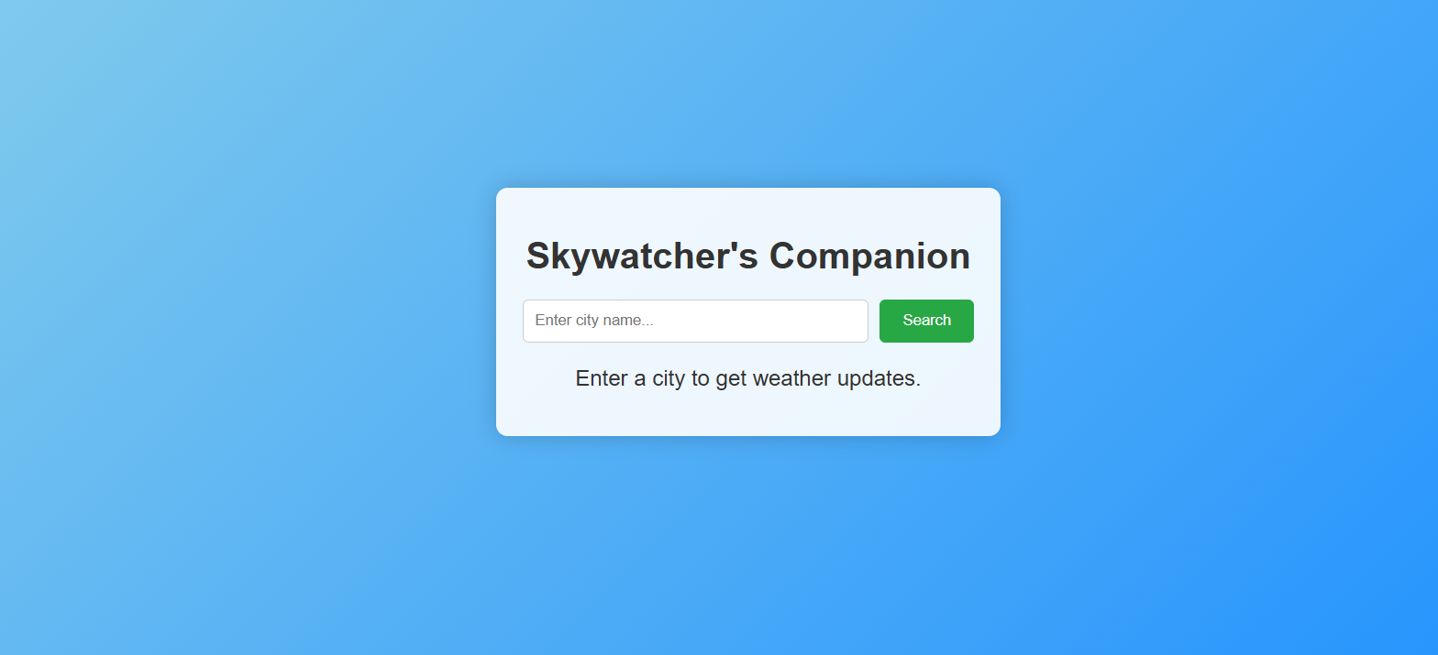
Website Image:-

Slide 23
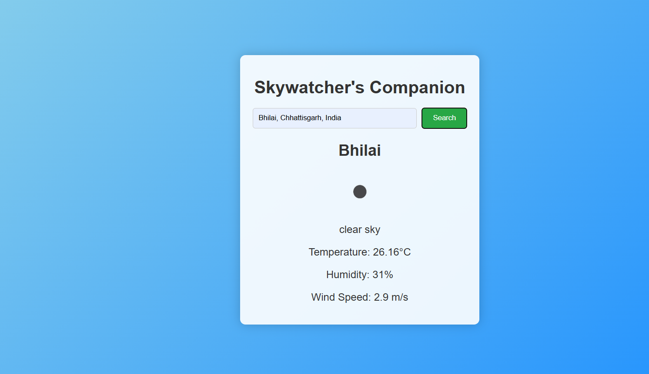
Website Image:-

Slide 24
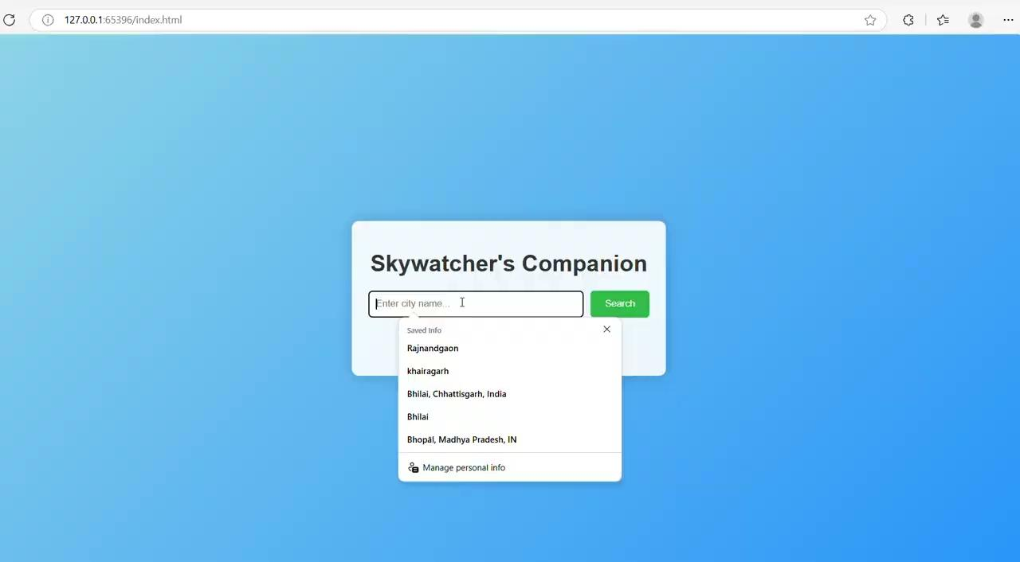
Website Video:-

Slide 25
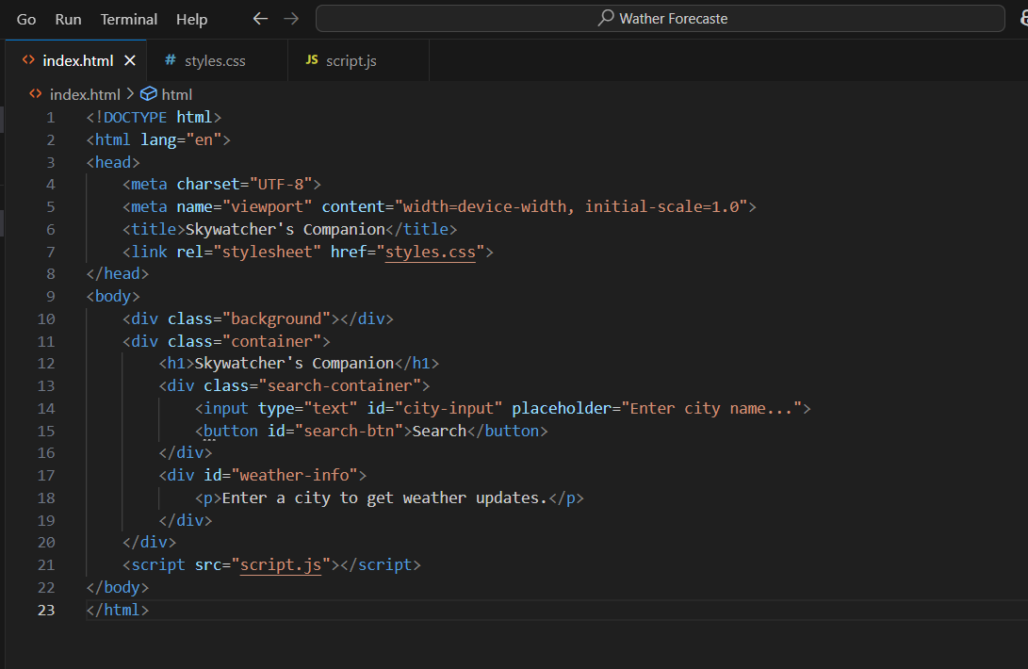
Code:-

Slide 26
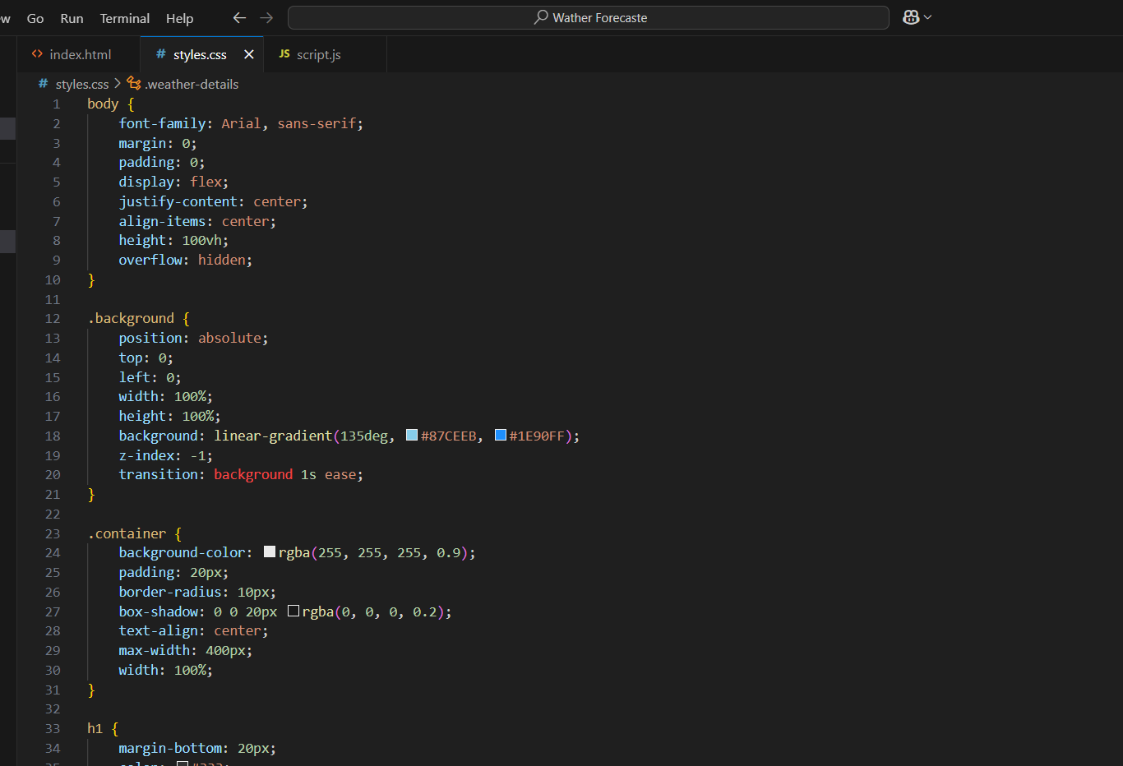
Code:-

Slide 27
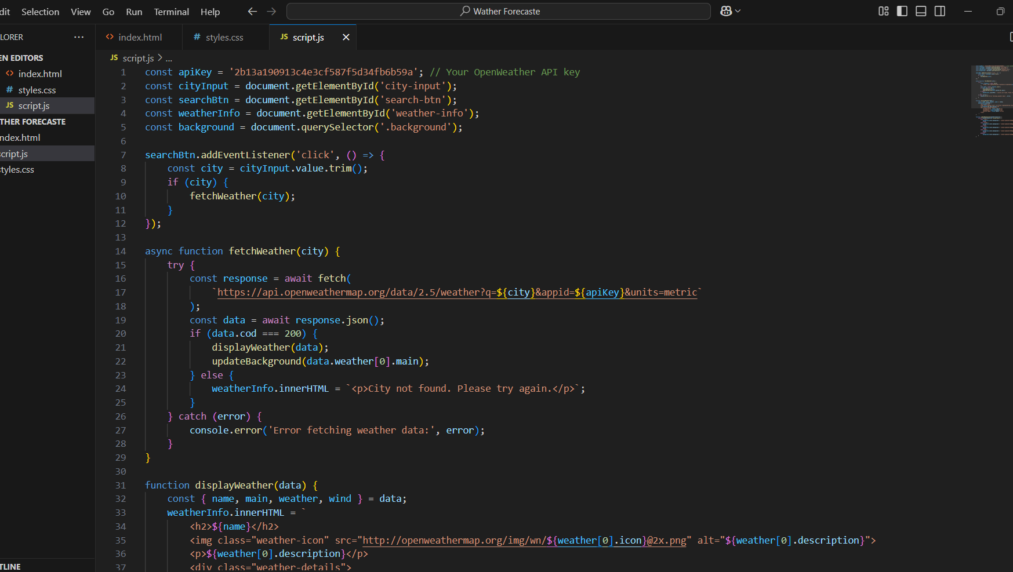
Code:-

Slide 28
Output:-
The Skywatcher's Companion project successfully demonstrates the integration of real-time weather data into a user-friendly web application. By utilizing HTML, CSS, and JavaScript, along with the OpenWeather API, the project provides an interactive experience where users can search for weather updates by city. The addition of a dynamic background enhances the visual appeal, making it both informative and engaging.
This project is a great way to practice API handling, JavaScript programming, and responsive design, making it a valuable learning experience for web development.

